Slide 1
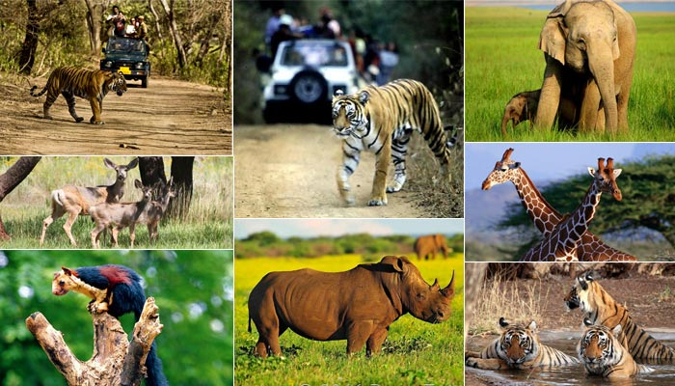
WILDLIFE SANCTUARY WEBSITE
ADIL AHMAD DAR – 20CS1004
BEENA SAMUEL – 20CS1020
M. HEMAPRIYA – 20CS1048

Slide 2
Problem statement:
The population of animals is decreasing day by day. This is due to the lack of a living space and unavailability of food due to human intervention into their habitats.
Many animals are hunted for their tusks, skin etc., We need to protect animals which are on the verge of extinction.
Therefore , we develop this online platform to create awareness about the sanctuary, its conservation efforts, the various species of animals found there, and the measures being taken to protect them.

Slide 3
Problem statement:
To create a sustainable and responsible tourism model that balances the conservation of wildlife and their habitats with the economic benefits derived from tourism.
To provide an enjoyable and educational experience for tourists while also ensuring the safety and welfare of the animals, promoting environmental awareness and conservation, and contributing to the local community's economic development.
To enable an interactive mode for the convenience of tourists to book tickets and rides, reserve rooms, provide feedbacks and much more.

Slide 4
Objectives:
To attract tourists by providing information about the unique experiences, attractions, rides and activities available.
Enhancing online presence: To enhance the sanctuary's online presence, making it more visible and accessible to potential visitors and creating a positive image for the sanctuary.
Improving visitor experience: To improve the visitor experience by providing comprehensive information about the sanctuary, including visitor guidelines, sightseeing options, and accommodation.

Slide 5
Objectives:
Educating visitors: To educate visitors about the importance of conservation efforts, the impact of human activities on wildlife and the environment, and how they can help protect the natural world.
Measuring success: To measure its success by tracking metrics such as tourists numbers, revenue generated, tourists satisfaction ratings and feedbacks, and conservation impact, and using this data to make informed decisions about future initiatives and investments.
Utilizing social media: The website can leverage social media platforms to reach a wider audience, engage with visitors, and promote the sanctuary's offerings and initiatives.
Boosting revenues: The website could be designed to generate revenue by tourism and encouraging visitors to donate to support conservation efforts.

Slide 6
TECHNOLOGY STACK
TYPE | TECHNOLOGY
Frontend | React JS
Backend | Spring Boot
Database | MySQL
ORM Mapping | JPA Hibernate
Static code analysis | SonarLint
Collaboration | Github
API Testing | Postman
Testing | Junit Mockito
Code Coverage | EclEmma
Deployment | Docker

Slide 7
Software used
XAMPP Control Panel v3.3.0
Visual Studio Code
Spring Tool Suite 4 (STS)
Postman
Docker desktop
Github desktop

Slide 8
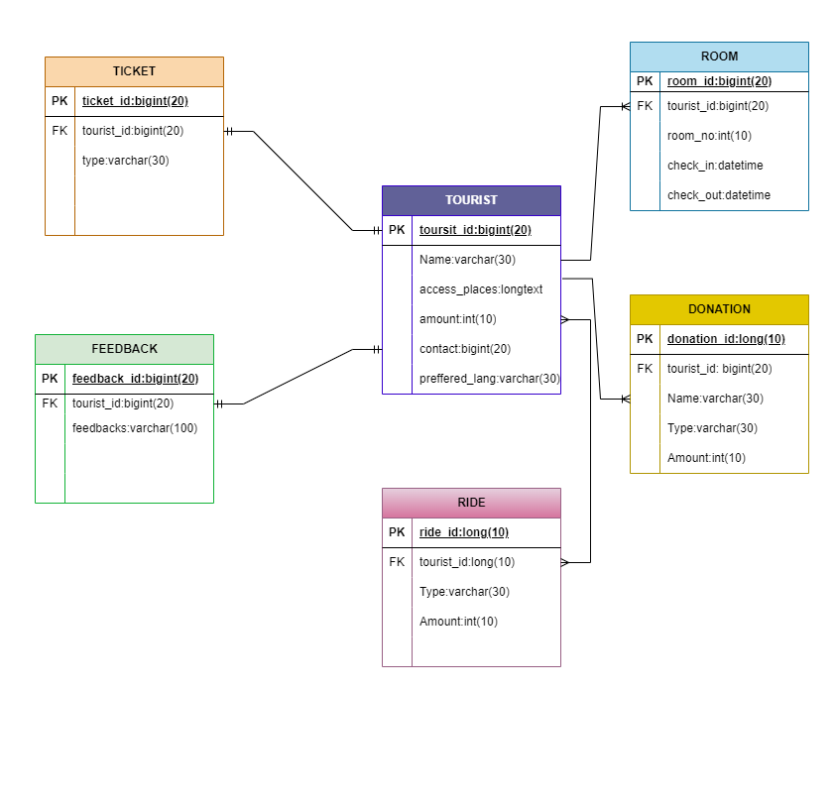
Entity Relation diagram:

Slide 9
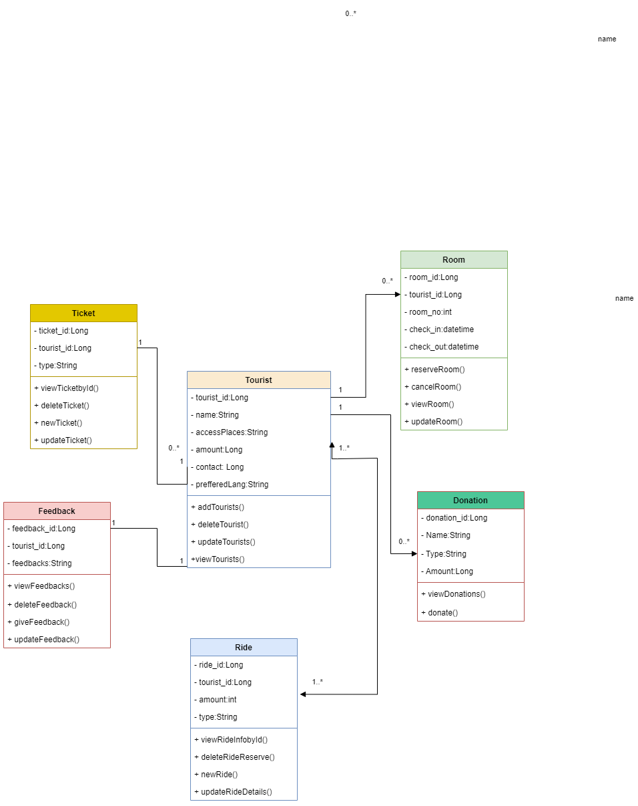
Class diagram:

Slide 10
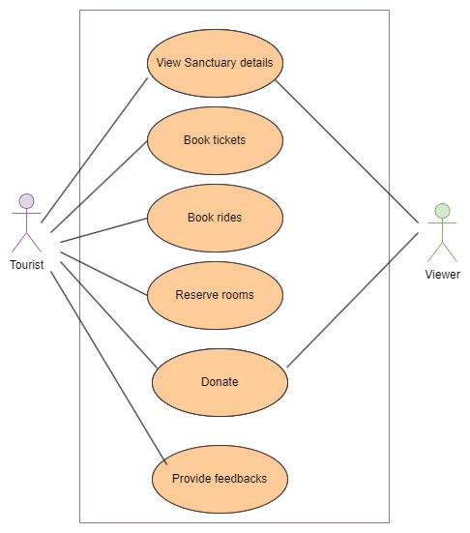
Use case diagram:

Slide 11
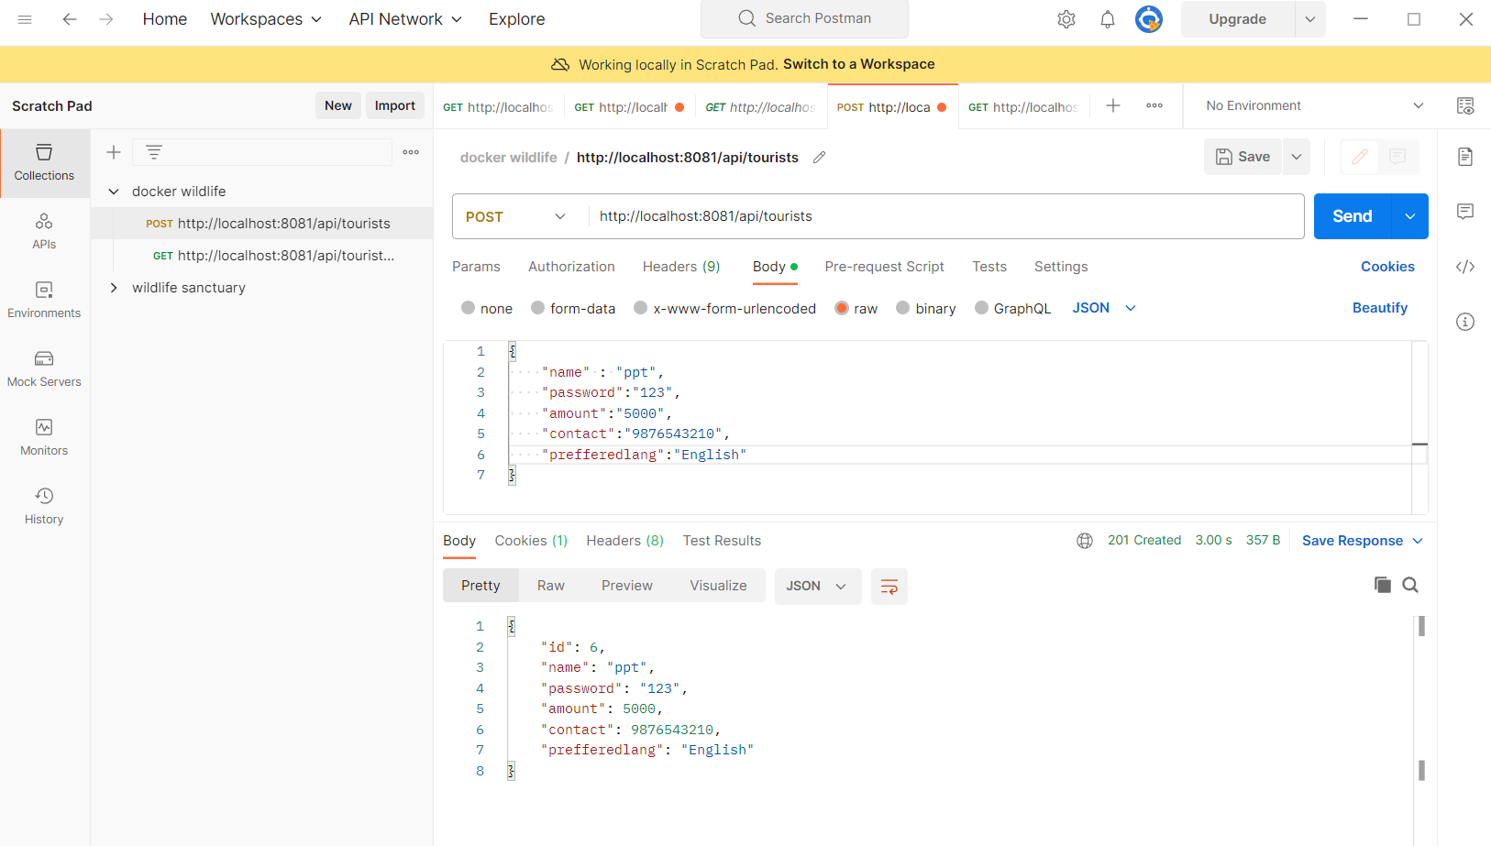
API TESTING
Tool - Postman

Slide 12
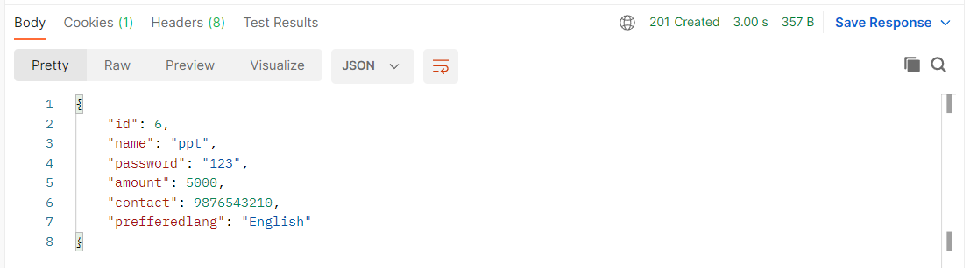
API TESTING
Tool - Postman

Slide 13
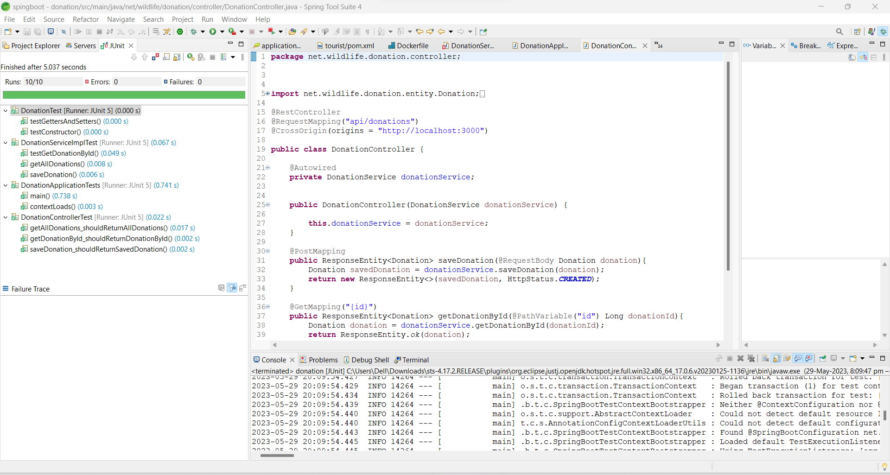
TESTING
Using Junit Mockito

Slide 14
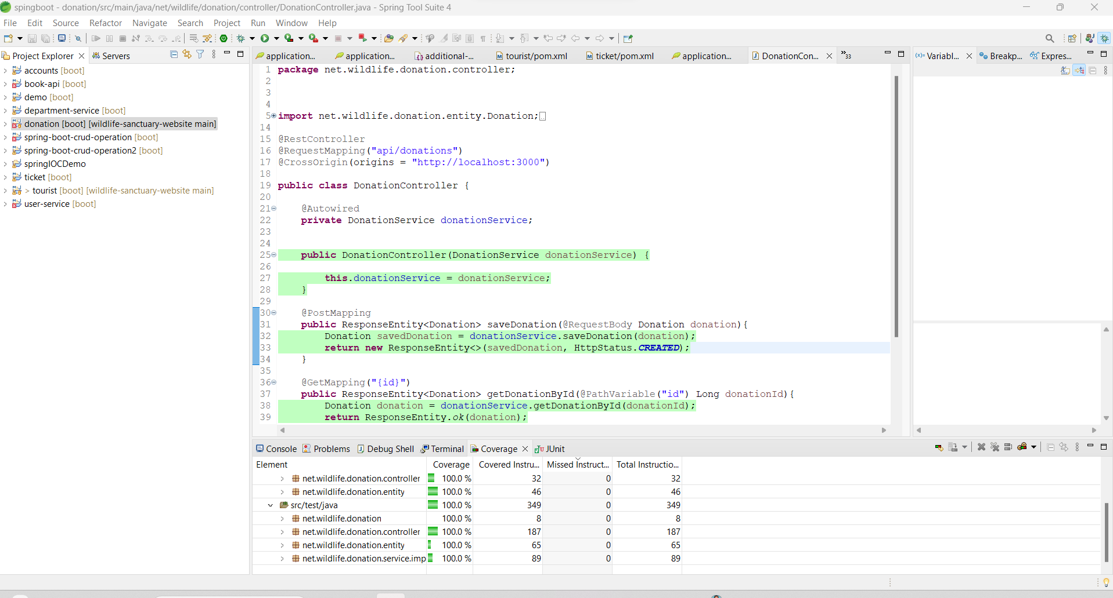
CODE COVERAGE
EclEmma

Slide 15
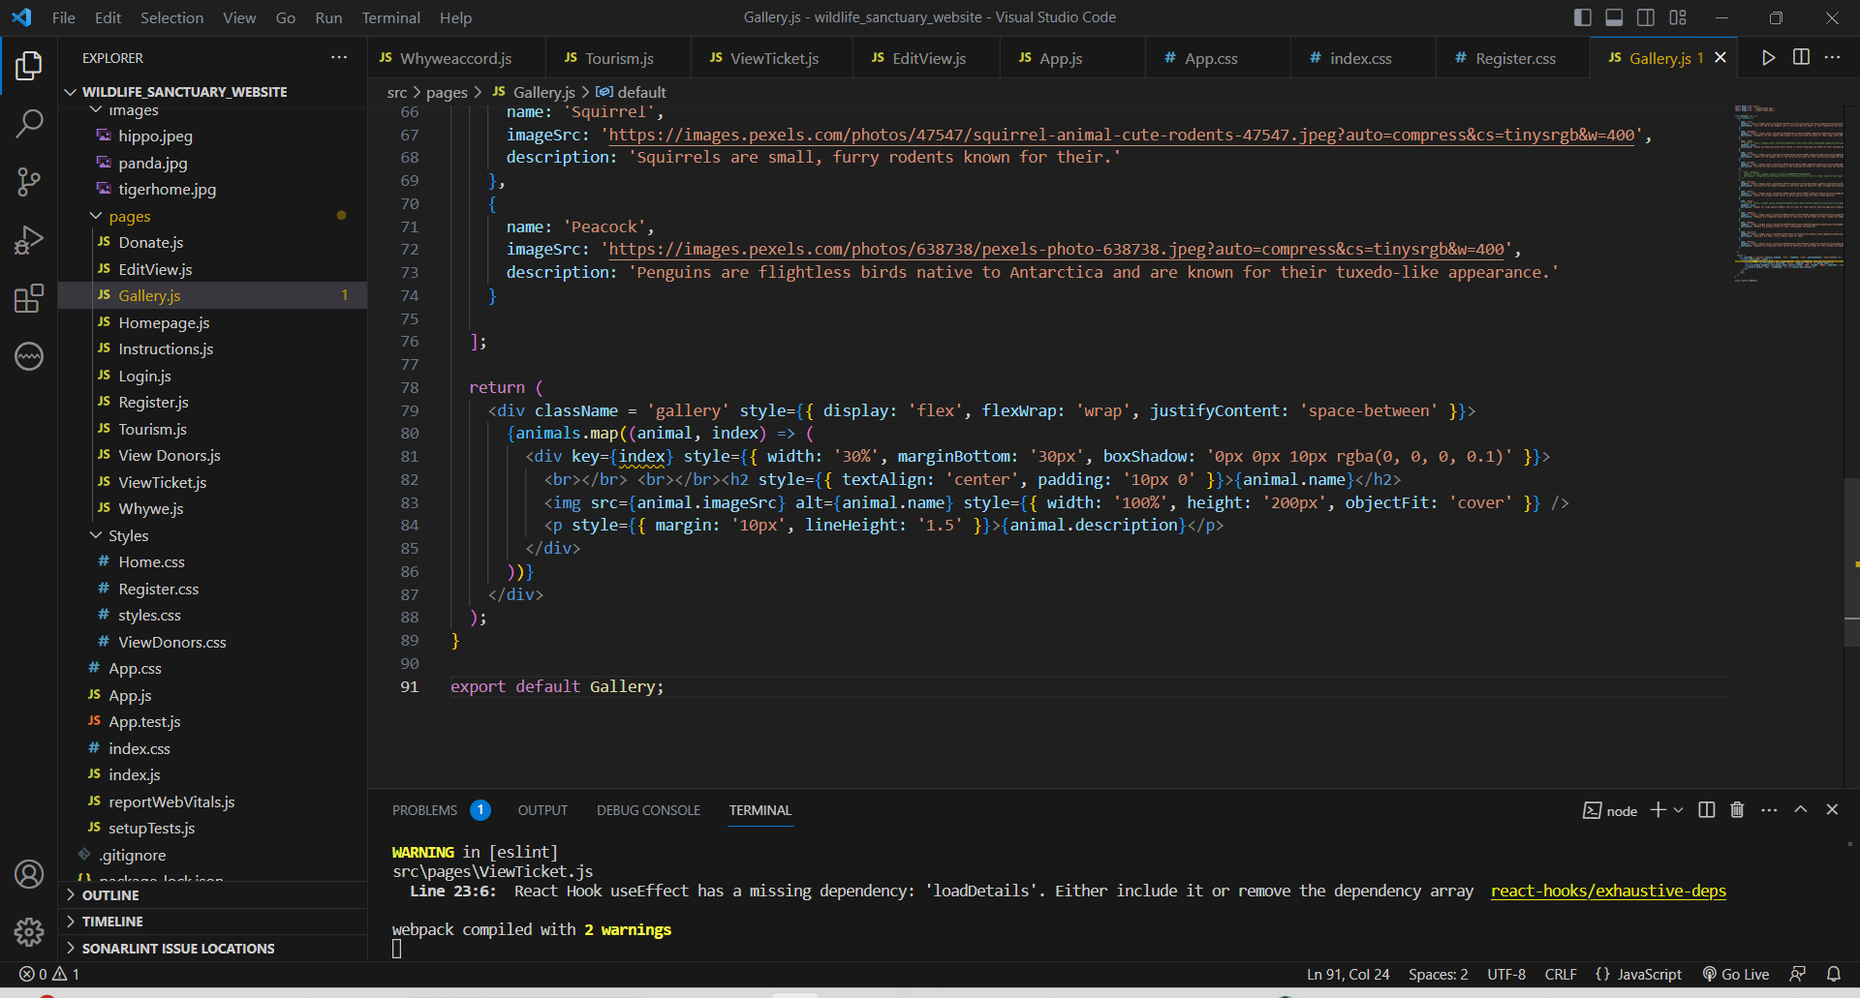
Static code analysis

Slide 16
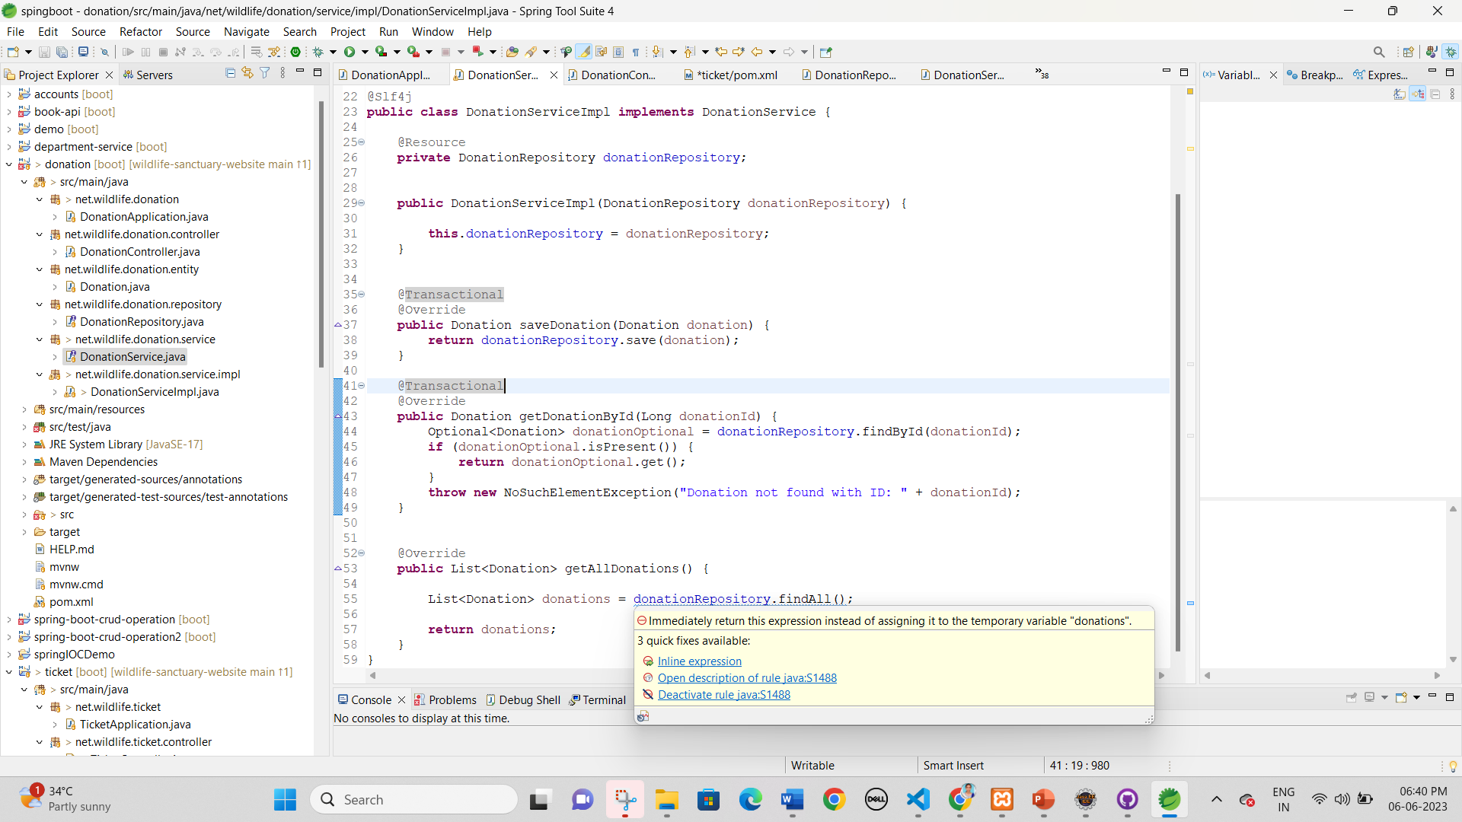
Static code analysis

Slide 17
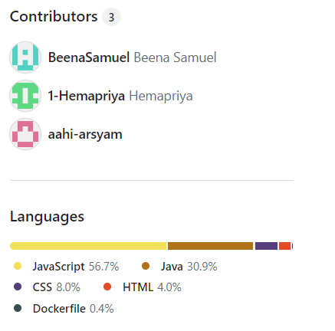
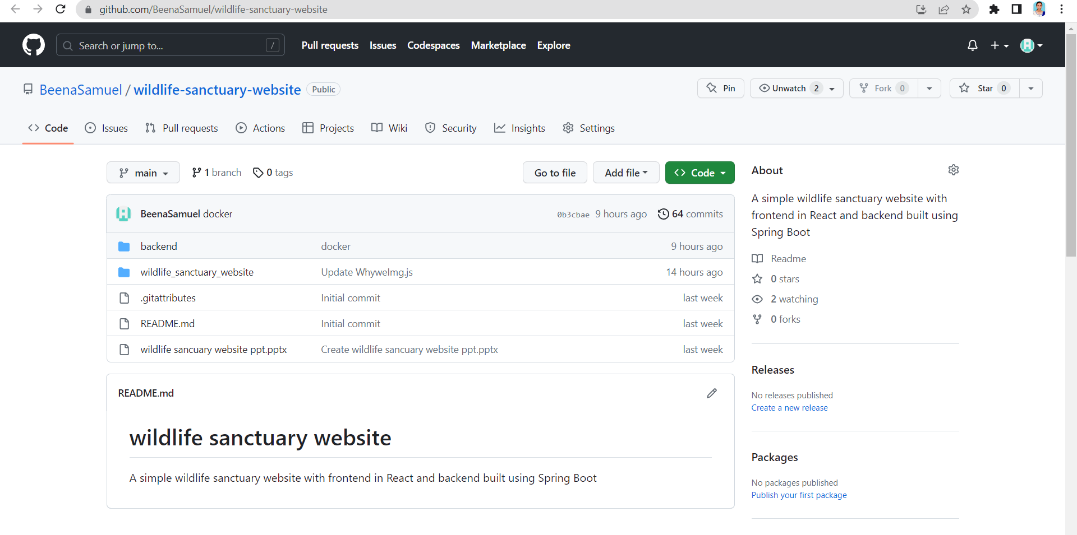
Collaboration

Slide 18
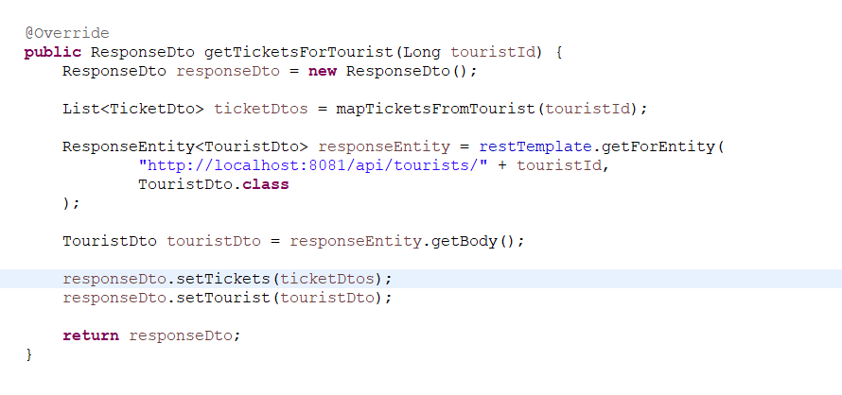
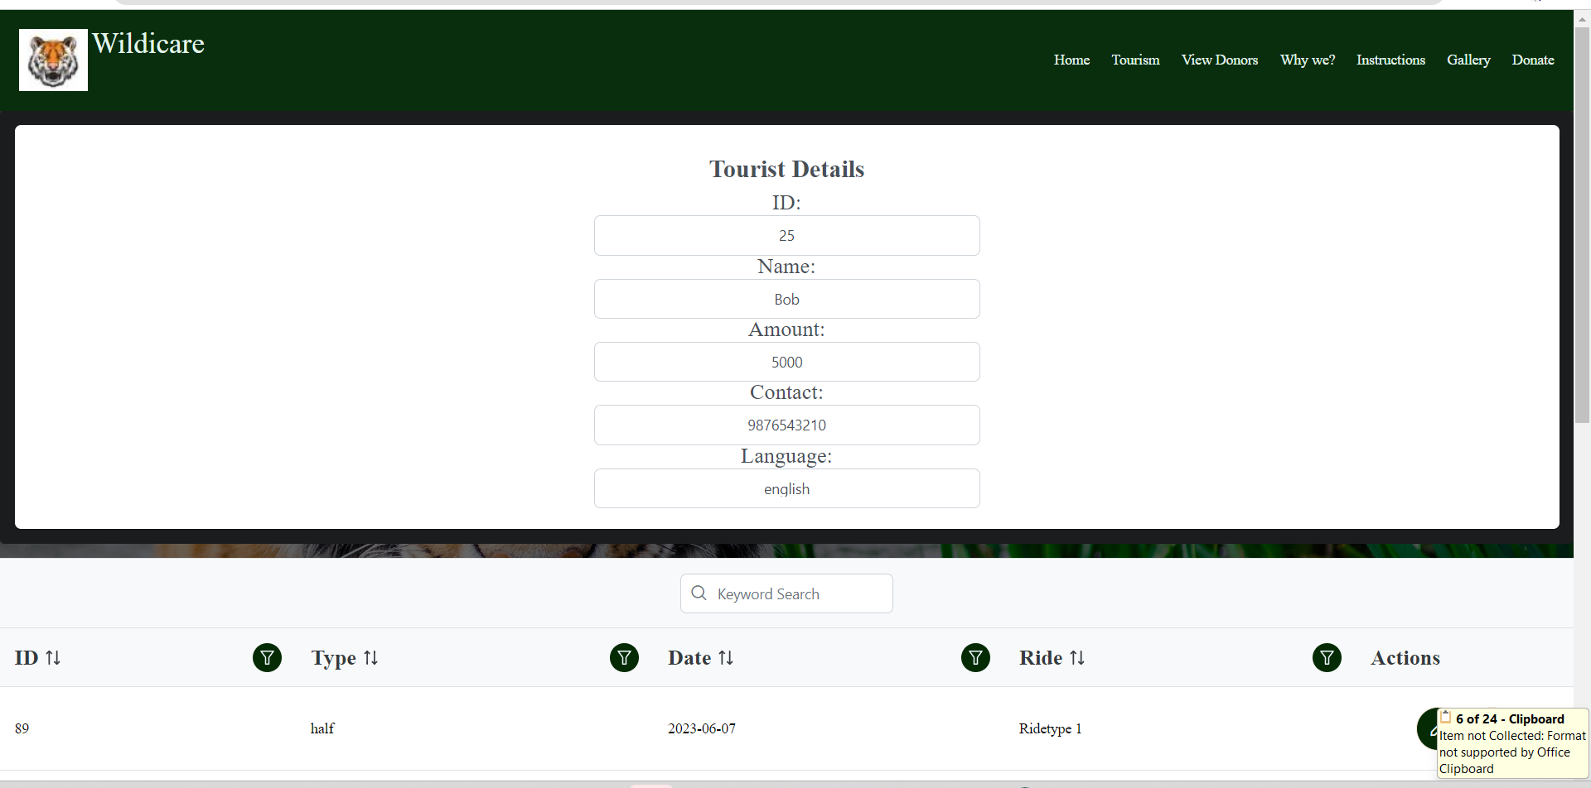
MICROSERVICES

Slide 19
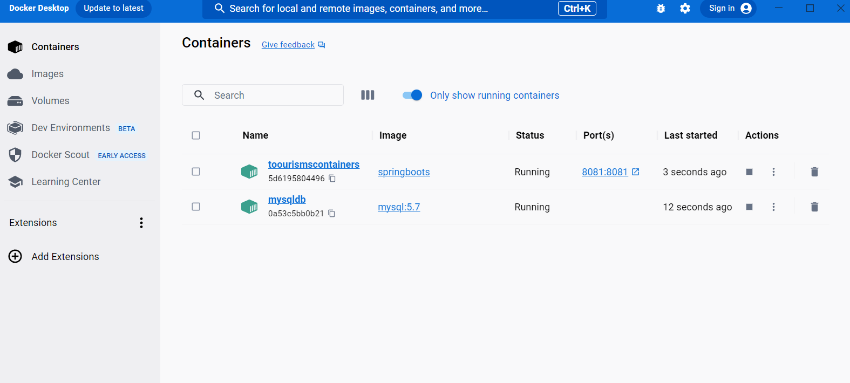
DEPLOYMENT

Slide 20
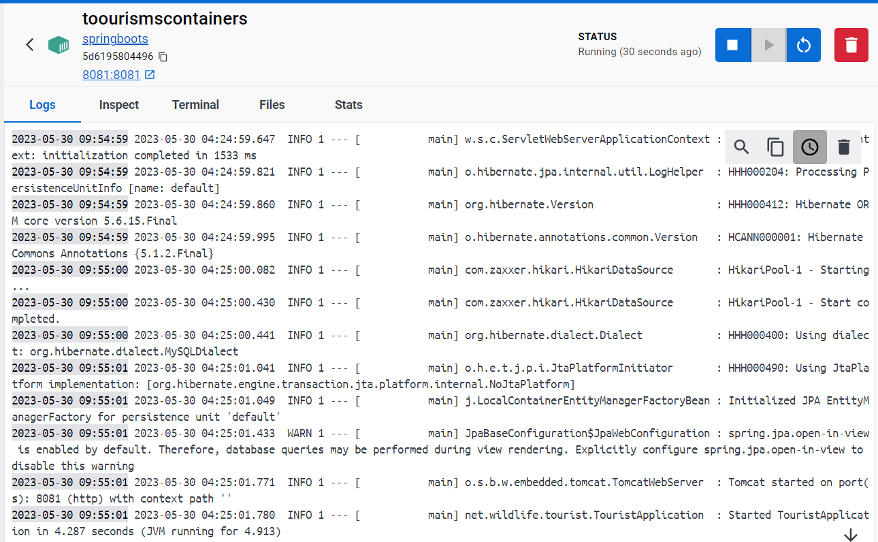
DEPLOYMENT

Slide 21
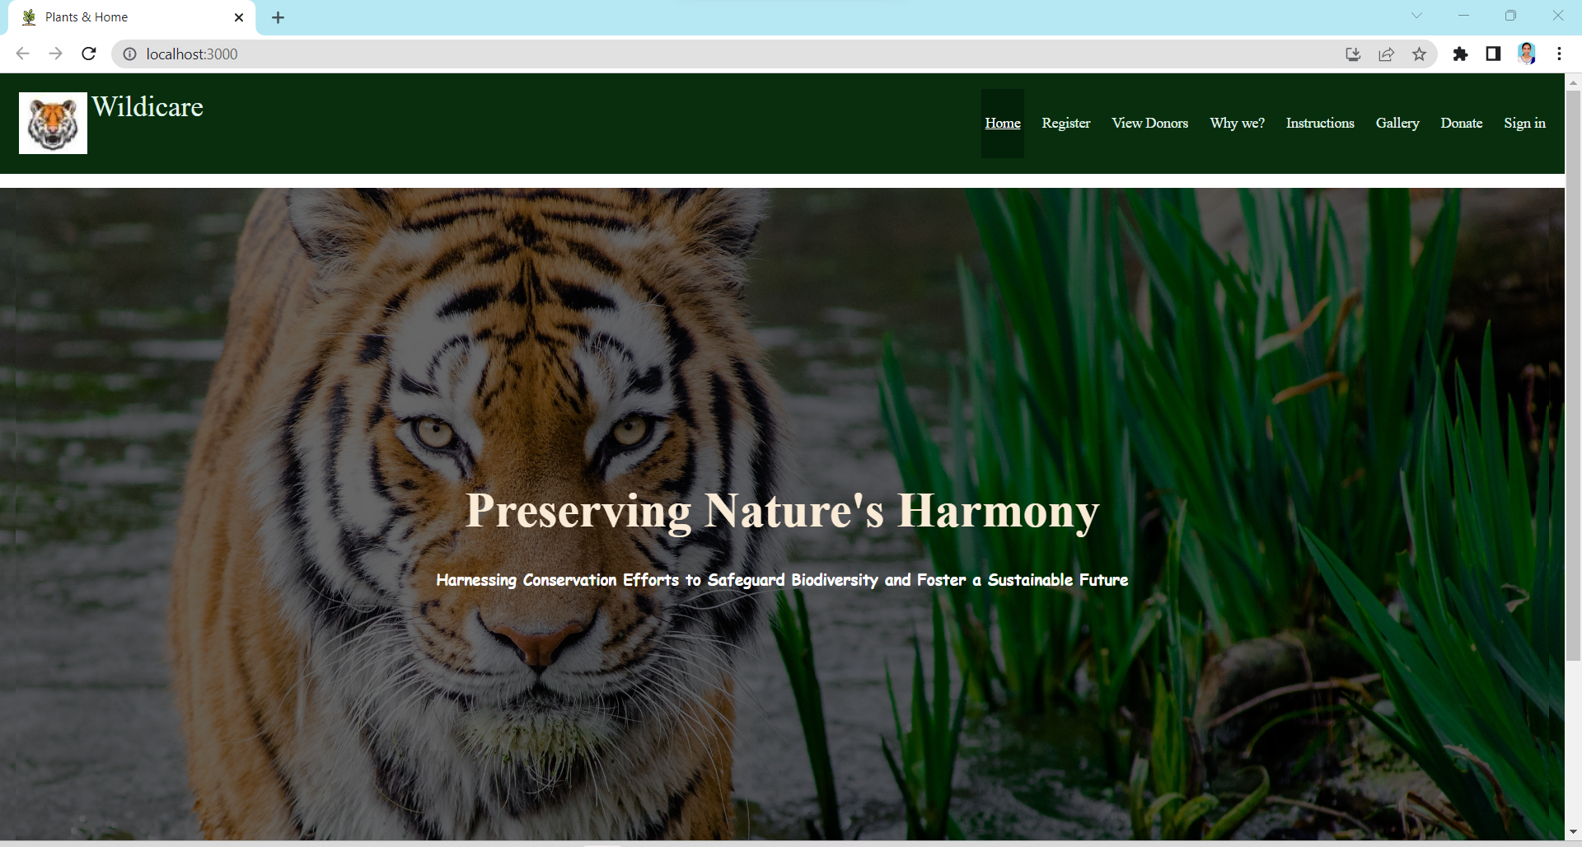
THE FRONTEND (Homepage)

Slide 22
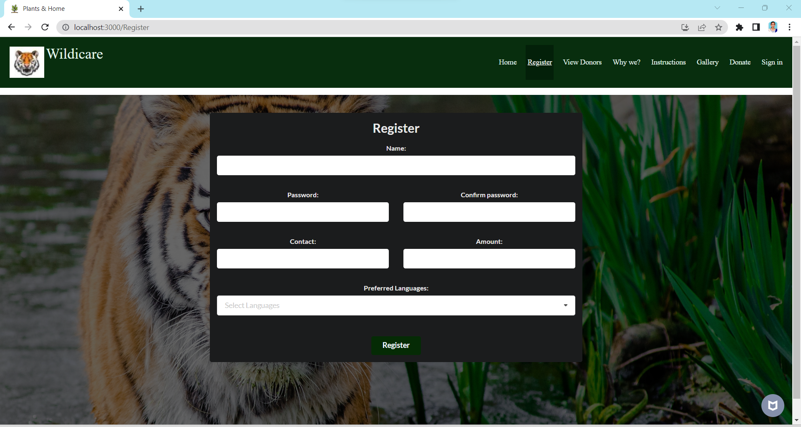
THE FRONTEND (Register)

Slide 23
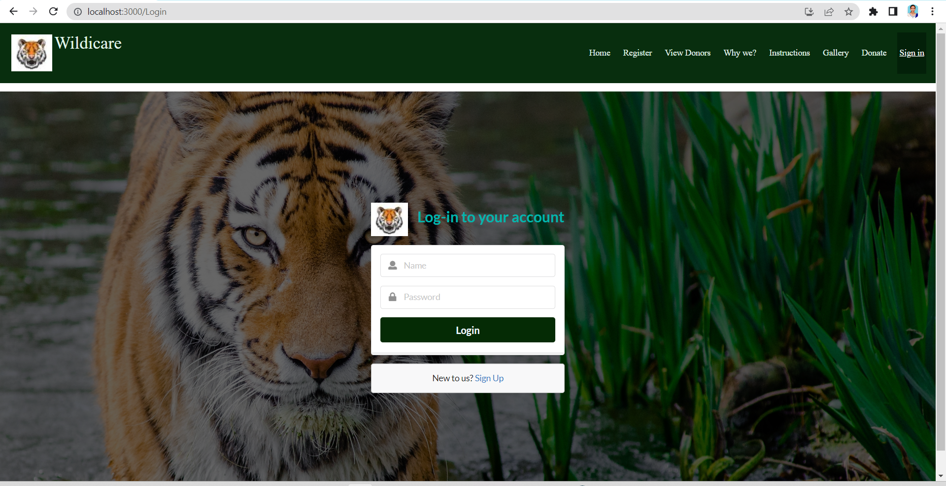
THE FRONTEND (Login)

Slide 24
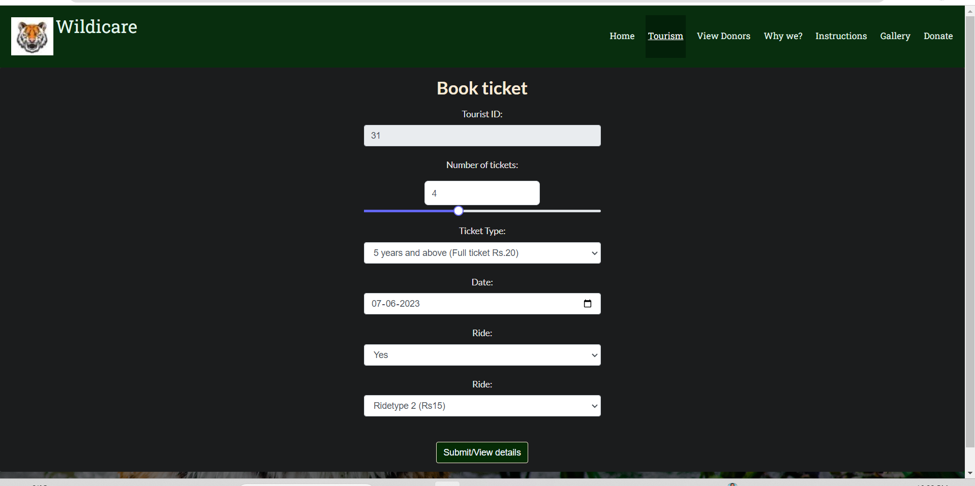
THE FRONTEND (Ticket booking)

Slide 25
THE FRONTEND (View tickets)

Slide 26
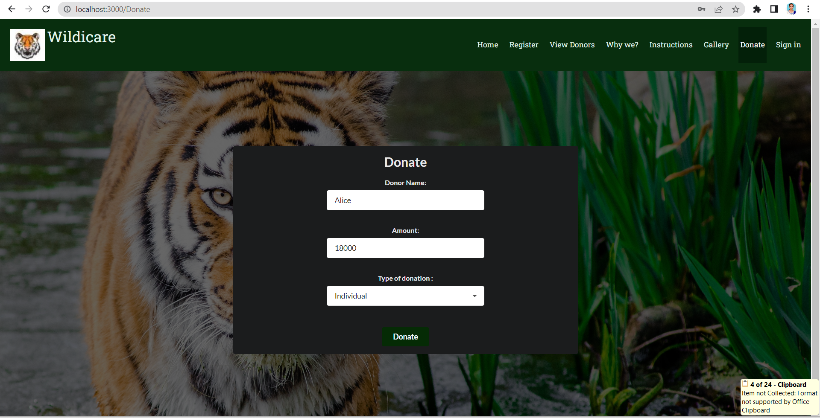
THE FRONTEND (Donate)

Slide 27
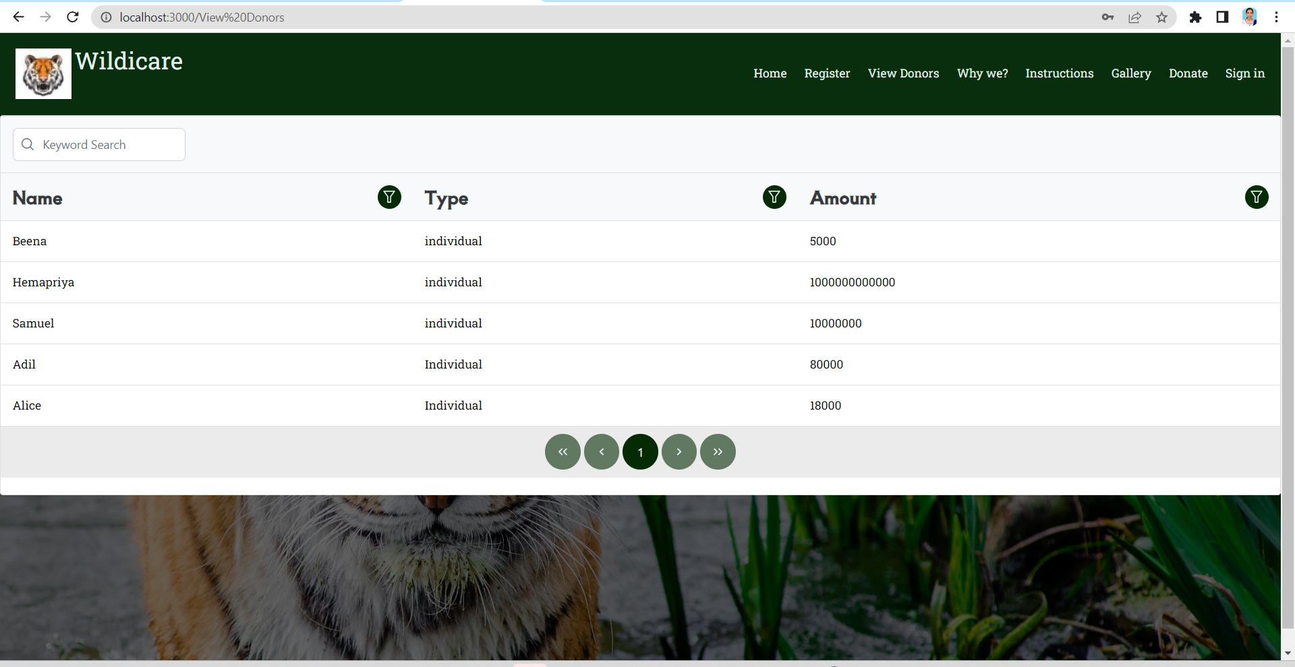
THE FRONTEND (View Donors)

Slide 28
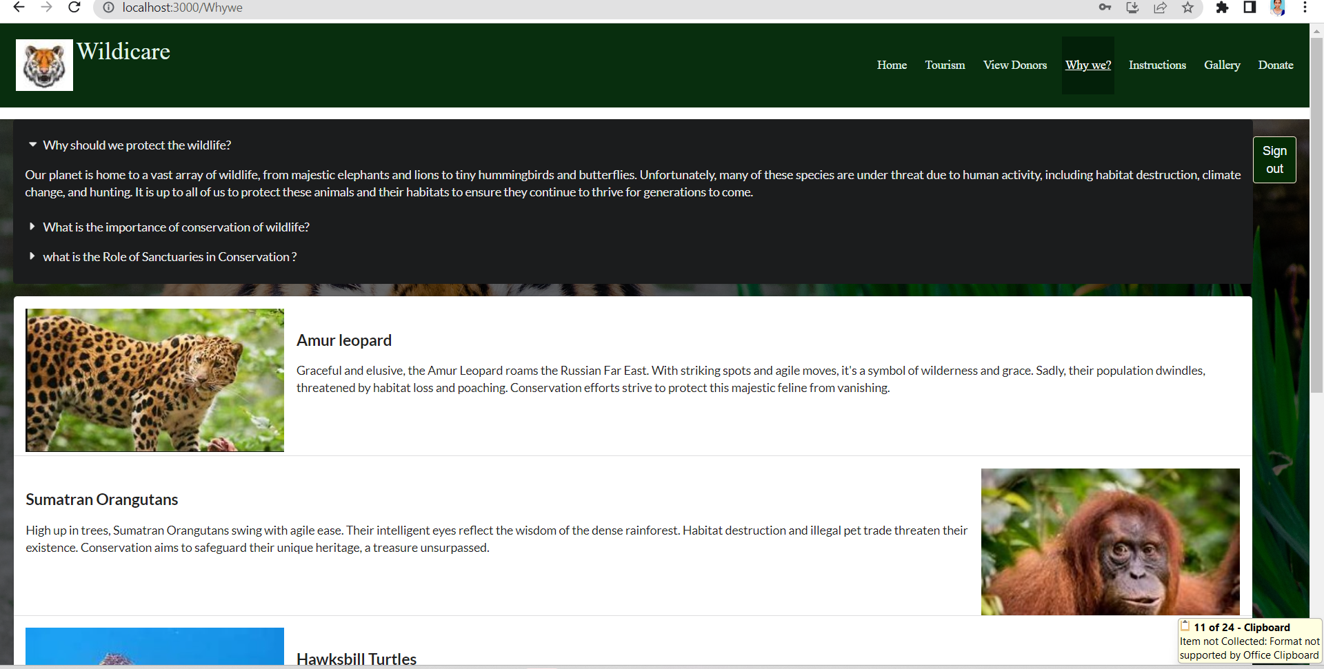
THE FRONTEND (Why we?)

Slide 29
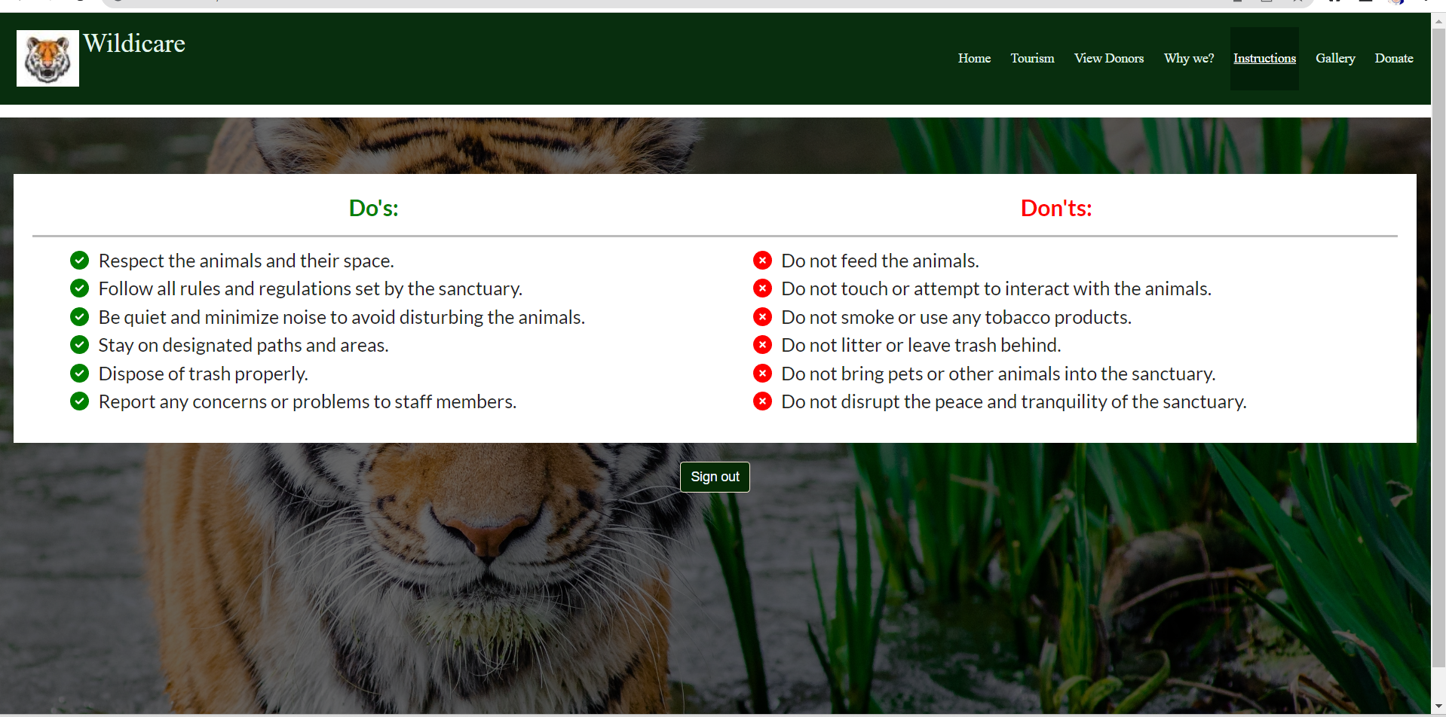
THE FRONTEND (Instructions)

Slide 30
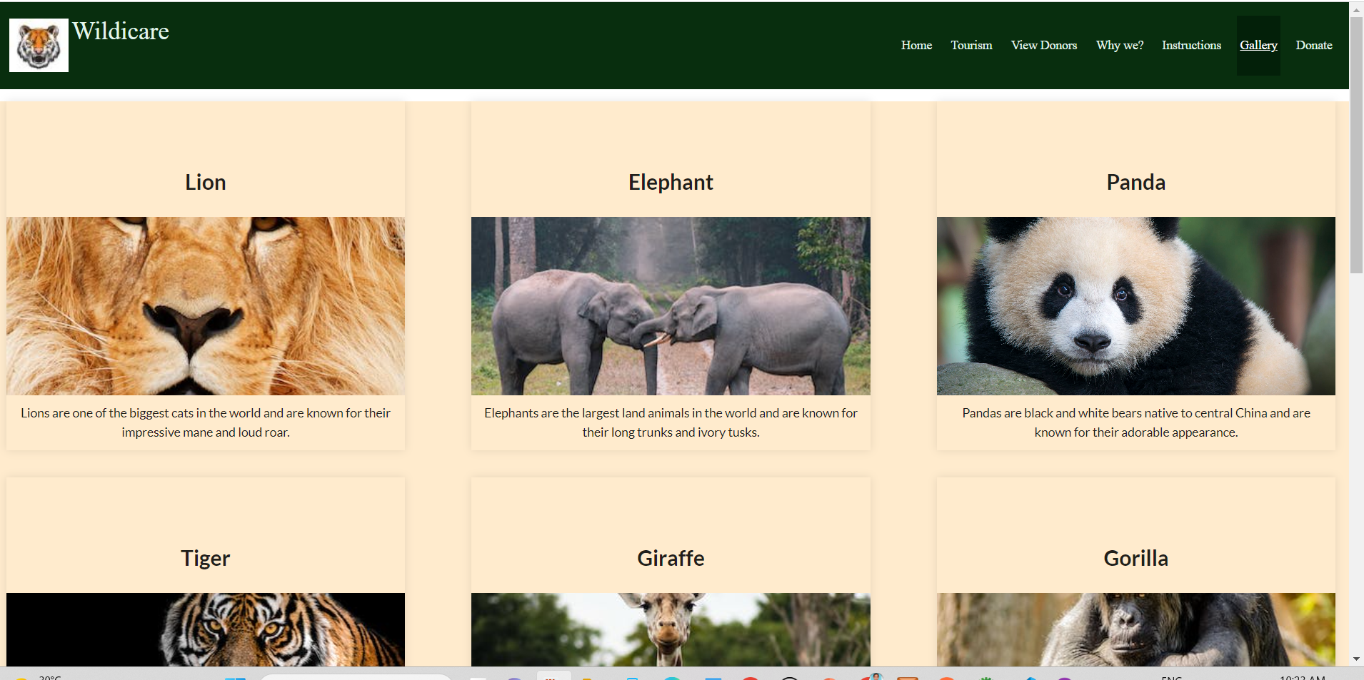
THE FRONTEND (Gallery)

Slide 31
FUTURE ENHANCEMENTS
Room booking
Feedbacks
Real payment portal redirection
Statistics of sanctuary visits, donations, etc .

Slide 32
Conclusion
Therefore , this Wildlife sanctuary website aims to create an awareness about the importance of conservation and also helps to manage the different functionalities like ticket booking, ride booking, etc. It also enables facilities for donation thereby improving the conservation efforts

Slide 33
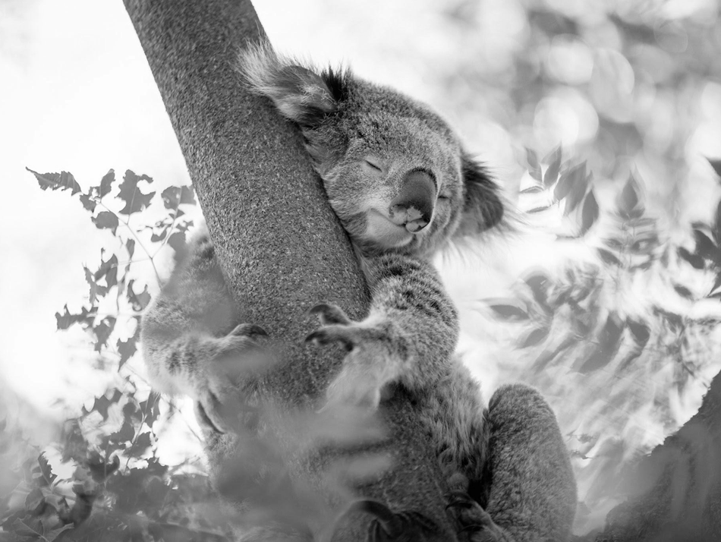
THANK YOU

